Slide 1
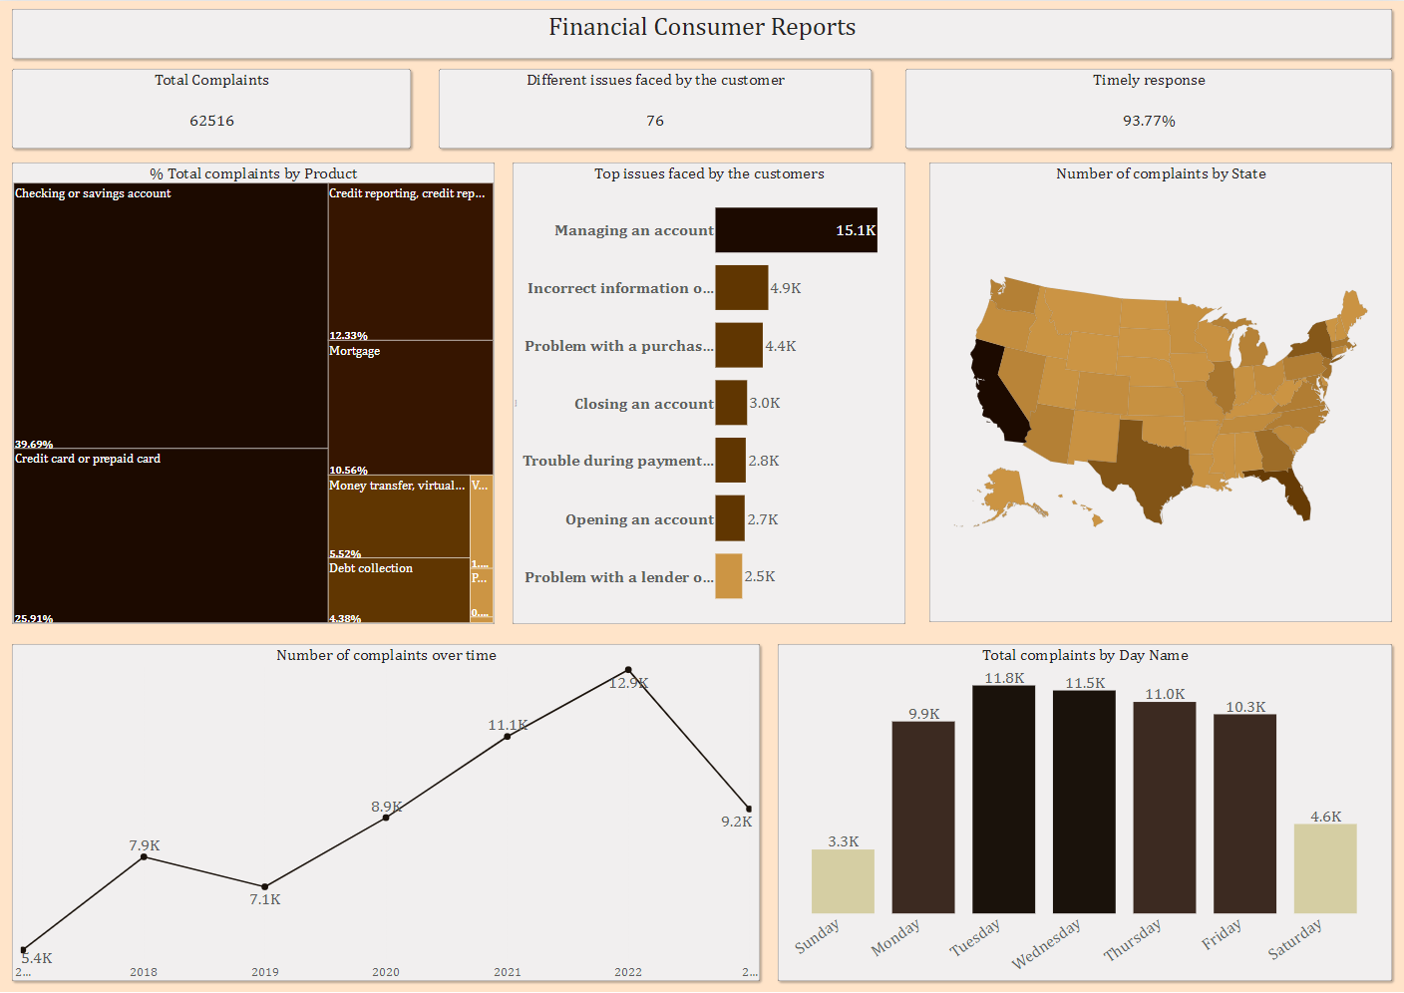

Slide 2
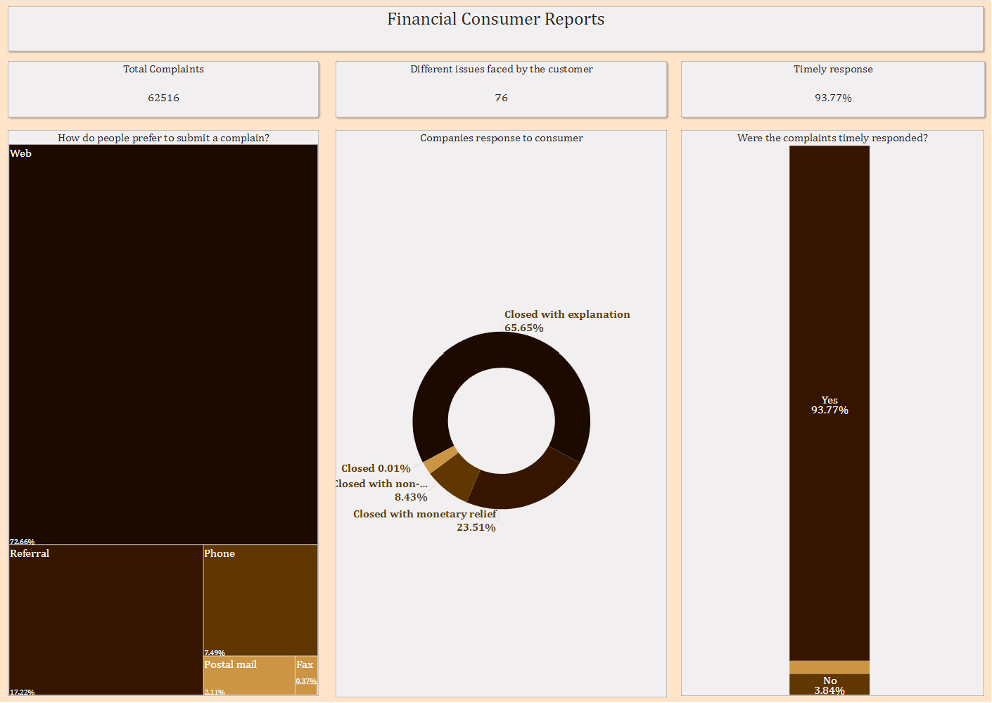

Slide 3
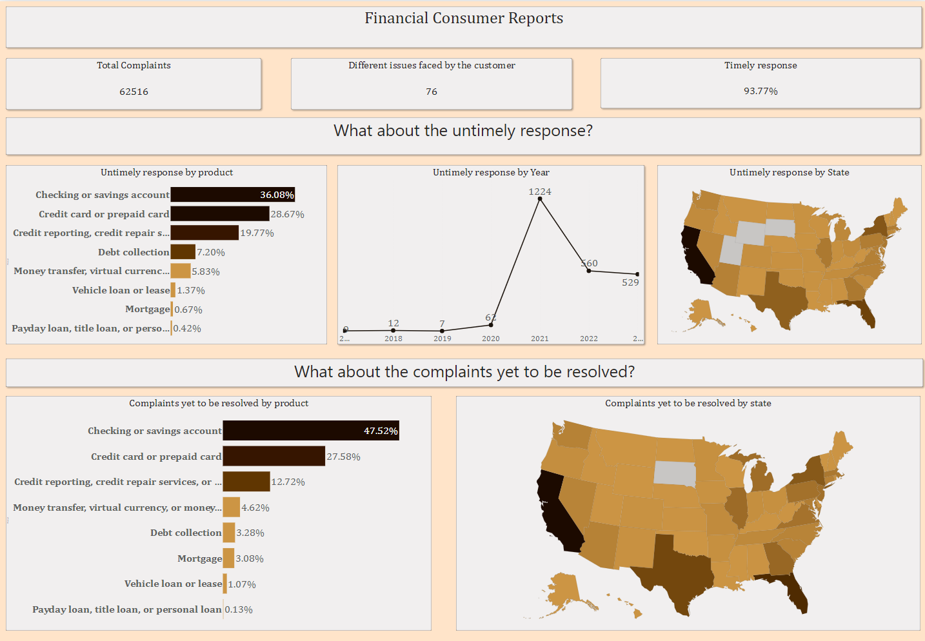

Slide 4
Insights
Total complaints were 62516,out of which nearly 93.77% complaints were timely responded.
Two products with the highest complaints were Checking or Savings account,Credit card or prepaid account.
Top 3 issues faced by customers are Managing an account,Incorrect information on the report,Problem with the purchase shown in the statement.
Highest number of complaints were received from California.
The number of complaints were highest in the year 2022 at 12.9 K, second highest number of complaints were recorded in the year 2021 at roughly 11K.
Number of complaints recorded on weekend days were much less than weekdays.

Slide 5
g) People prefer to complain through Web(at 45423 complaints) and web referral is the least preferred with just 90 out of a total of roughly 62000 complaints.
h) Nearly 94 % of the complaints were timely responded while just 4% of complaints were not responded timely,Remaining complaints are yet to be responded.
i)Roughly 65% of the Complaints were closed with explanation. Approximately a quarter of complaints were provided monetary relief. Exactly 2.39% of complaints are yet to be resolved.
j) Just about 60 % untimely response were from Credit Card or prepaid account,Checking or savings account product.
k) Out of all the complaints yet to be resolved exactly 47.52% of them are related to Checking or Savings account.

